Slide 1

ACAD
SEARCH
CS 328 - Intro to Data Science
A crowd-sourced search engine to find leading professors

Slide 2

MOTIVATION
Students often need to search for professors.
Google Scholar provides less control over search results.
A tool focused towards students searching for professors.

Slide 3

OBJECTIVES
Search Engine for professors based on name, topic, paper title, etc.
Ranking and filtering based on h-index, citations over last 5 years, conferences, etc.
Ranking metric based on the data.

Slide 4

HIGH LEVEL
ARCHITECTURE

Slide 5
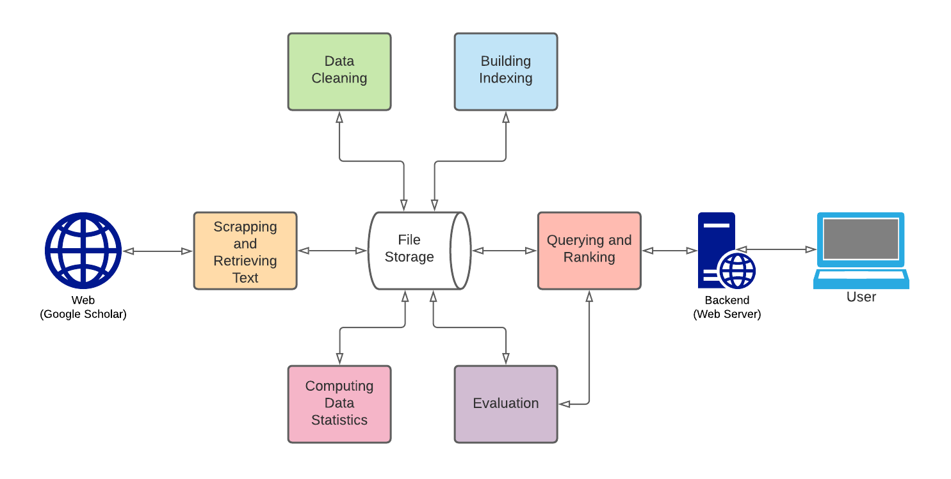

Slide 6

DATA COLLECTION

Slide 7
SOURCE
List of Google Scholar IDs from CSRankings GitHub Repository
20K
16.5K
13.2K
Repo
Scraped
Cleaned

Slide 8
SCRAPING
Data scraped per professor:
• Name
• Affiliation
• Profile Image URL
• Verified Email at
• Homepage URL
• Research Topics List
• Citation (overall & 5 yrs)
• H-Index (overall & 5 yrs)
• I-Index (overall & 5 yrs)
• Citation List Year-wise
• Titles: Top 100 Cited Papers
• URLs: Top 100 Cited Papers

Slide 9

AVOIDING GETTING BLOCKED
Pass request headers to appear as a browser.
Random delays of 1-3 seconds between requests.
Divide across multiple IP addresses.

Slide 10

PRE
PROCESSING

Slide 11
CLEANING
TEXT PRE-PROCESSING
Removed redundant entries.
Some Google Scholar pages did not follow the same HTML conventions as the rest. Cleaned such corruptions using regular expressions.
Convert to lower-case.
Perform stemming.
Remove stop words.

Slide 12

DATA STATISTICS

Slide 13
BASICS
Number of professors | 13285
Number of institutions | 8716
Number of publications | 893575
Average number of publications per professor | 79.80
Size of data after cleaning | 232 MB

Slide 14
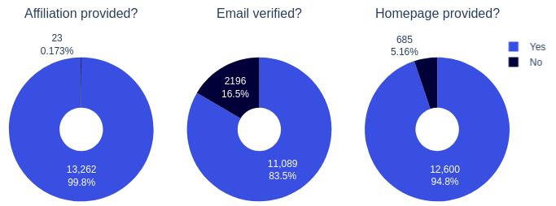

Slide 15
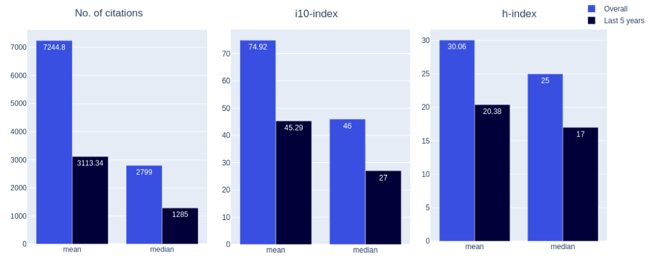

Slide 16
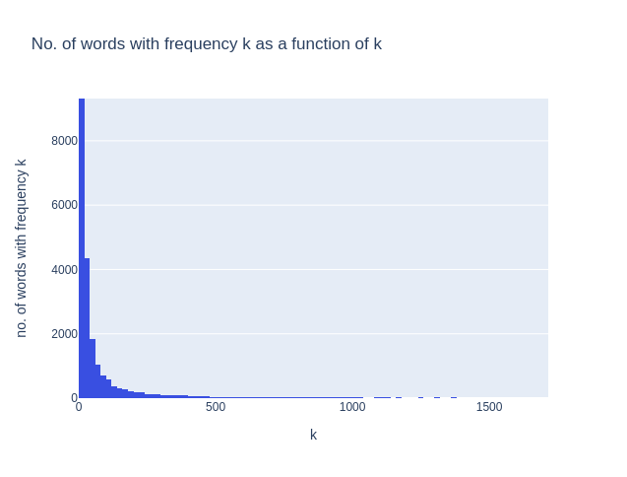

Slide 17

INDEXING

Slide 18
2 INDICES
INVERTED INDEX
Research topics and paper titles
Name and Affiliation(Institution)
{
‘machin’ : [ [0, 12], [3, 16],
[6, 9] ],
‘learn’ : [ [0, 13], [3, 17],
[8, 18] ]
}

Slide 19

QUERYING & RANKING

Slide 20
BOOLEAN RETRIEVAL
PHRASE RETRIEVAL
AND: Return professors that contain all the words from the query
OR: Return professors that contain at least 1 word from the query.
Allows users to search for exact matches for phrases.
The word positions stored in the inverted index is used.

Slide 21
TF-IDF
(Term Frequency-Inverse Document Frequency)
TF-IDF(t, d, D) = TF(t, d) x IDF (t, D)
TF: measure of how frequently a word/term appears in a document, normalised by the document size.
TF(t, d) = no. of times t appears in d ÷ total no. of words in d
IDF: measure of how much information a word provides, i.e., if it's common or rare across all documents.
IDF(t, D) = log[no. of documents ÷ (1 + no. of documents containing t)]

Slide 22
SORTING RESULTS
Users can sort search results based on no. of citations, h-index, no. of citations in last 5 years etc.
Boolean and phrase retrieval results are sorted using a default ranking metric.
DEFAULT RANKING METRIC
Linear combination of h-index, i10-index, no. of citations, h-index(last 5 yrs), i10-index(last 5 yrs), citations(last 5 yrs)

Slide 23

WEB SERVER
Built using Flask.
An interface for users to use the search engine.
Hosted here.

Slide 24
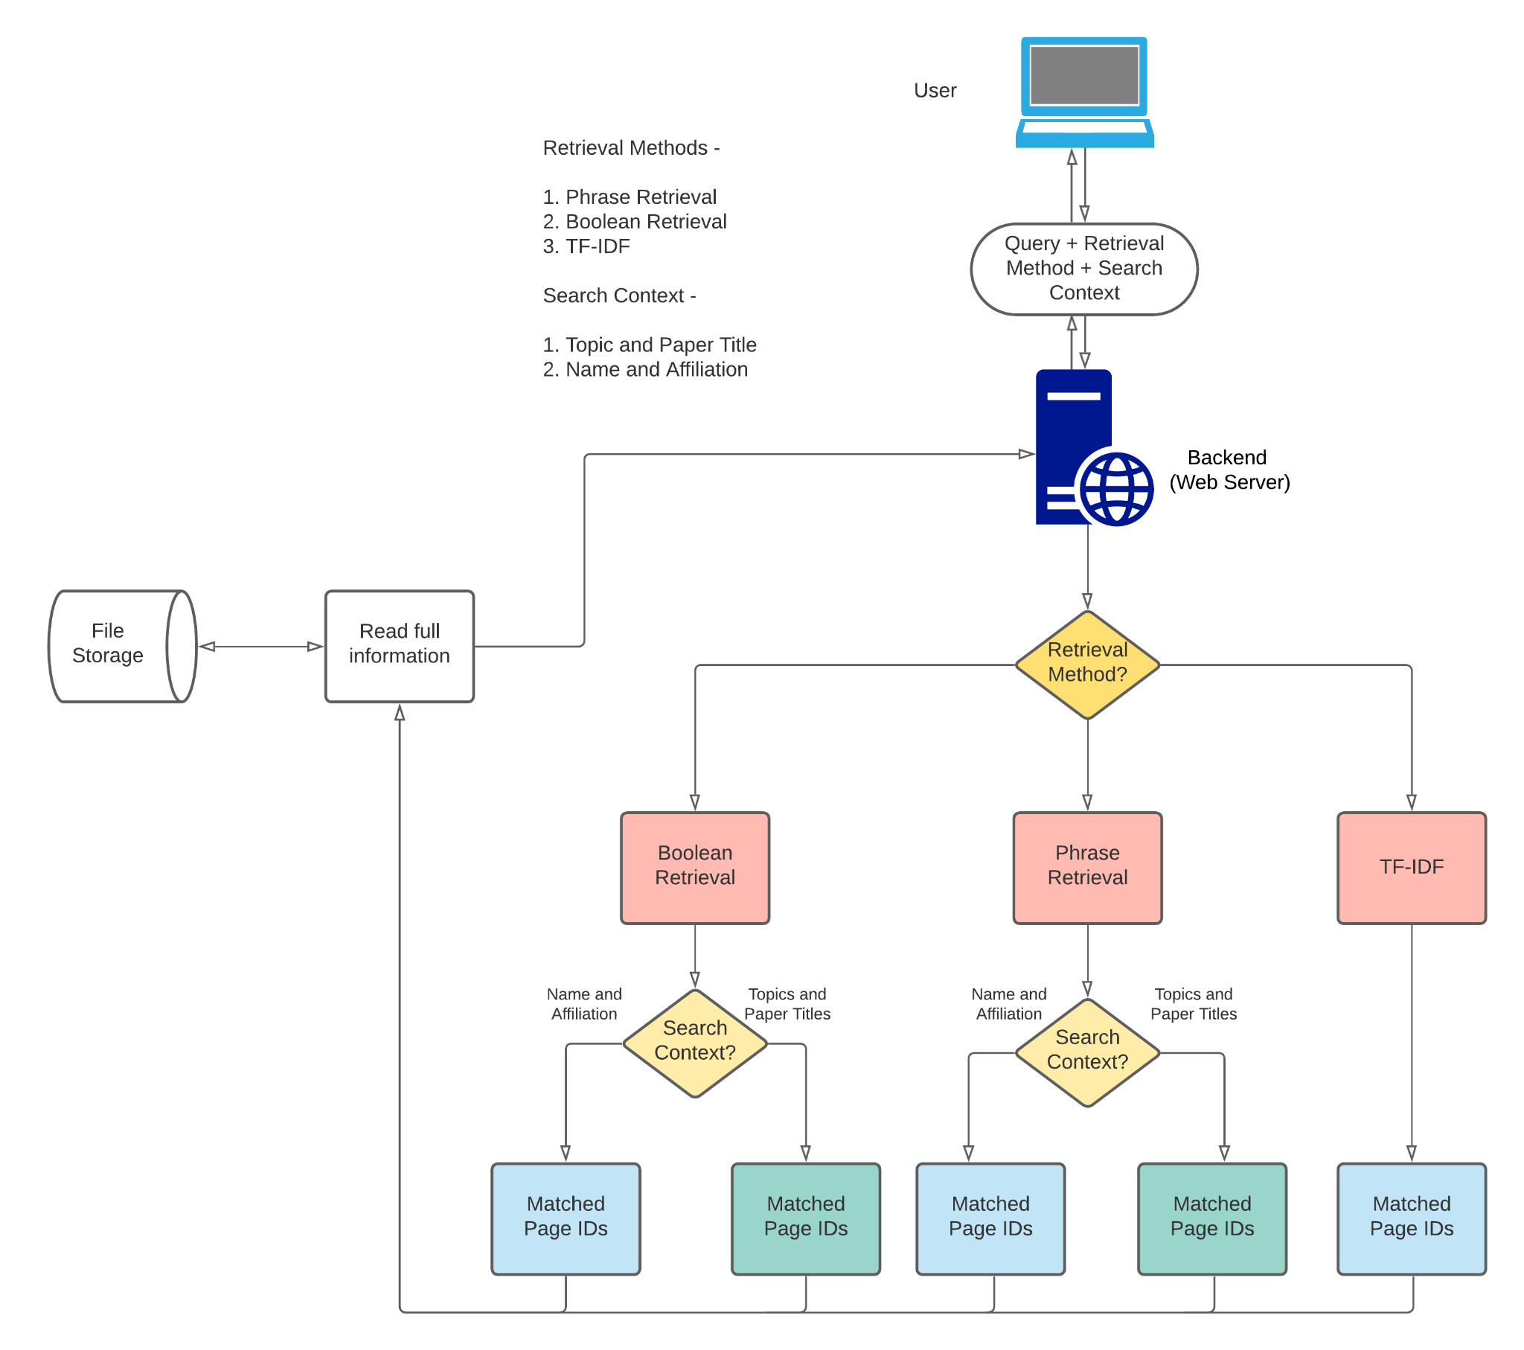

Slide 25

EVALUATION

Slide 26
MEDIAN RANK
Median of the ranks achieved by the ground truth in the search results, over a large number of searches.
RECALL RATE, R@X
Percentage of times that the ground truth appears in the top X results.
AVERAGE TIME PER QUERY
Time taken by retrieval algorithms to return matched document IDs.

Slide 27
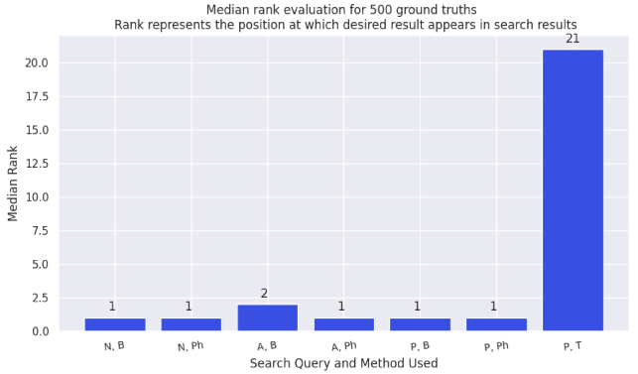

Slide 28
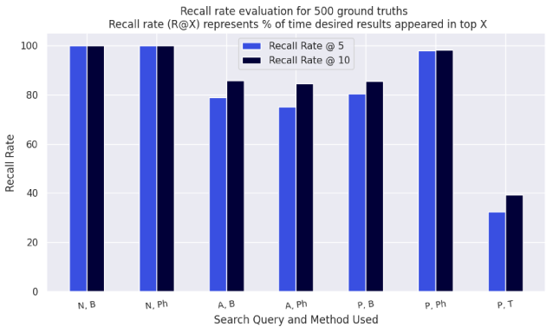

Slide 29
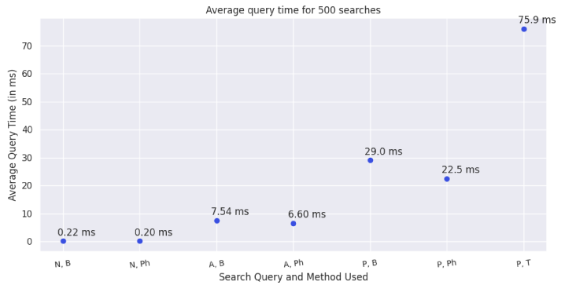

Slide 30

DEMO
Link to Web App

Slide 31

FUTURE
WORK

Slide 32
FUTURE WORK
Scraping more data
Improving user experience
Personalizing search results
Performing user tests
Using page ranking on citation data
Learning the default ranking metric from user feedback

Slide 33
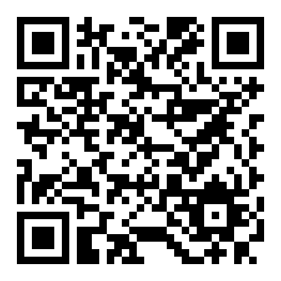
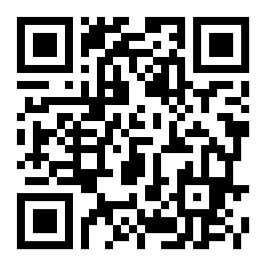
GitHub Repository: link
Web App: link
GROUP MEMBERS
Repo
Amey Kulkarni (18110016)
Chris Francis (18110041)
Nishikant Parmar (18110108)
ACKNOWLEDGEMENTS
Special thanks to Prof. Anirban Dasgupta for his valuable guidance and feedback.
Web App

